Slide 1


Titolo presentazione sottotitolo
Web-based application for the visualisation and analysis of the alpha citizen science study in Lagos, Nigeria
Milano, XX mese 20XX
Software Engineering for Geoinformatics - 2021
Group 4 : M. Abd Alslam, M. Abdalla Eldouma, D. Aguirre, L. Dragun

Slide 2
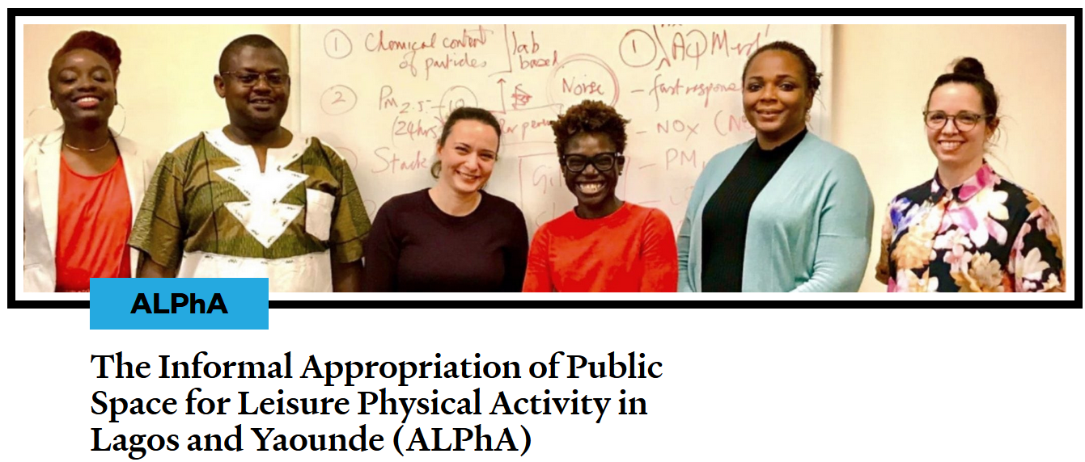
CONTEXTUALIZATION: THE ALPHA STUDY IN LAGOS
Active citizens claiming public space for exercise (ALPhA spaces)
Study to understand the types of spaces, the experiences of people, and the safety and injury risk exposures.
Community-led network that generates contextually local evidence for the re-design of urban infrastructure.

Slide 3
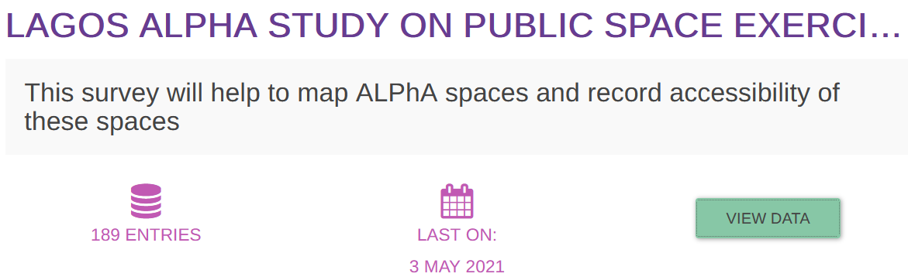
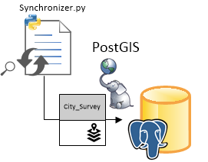
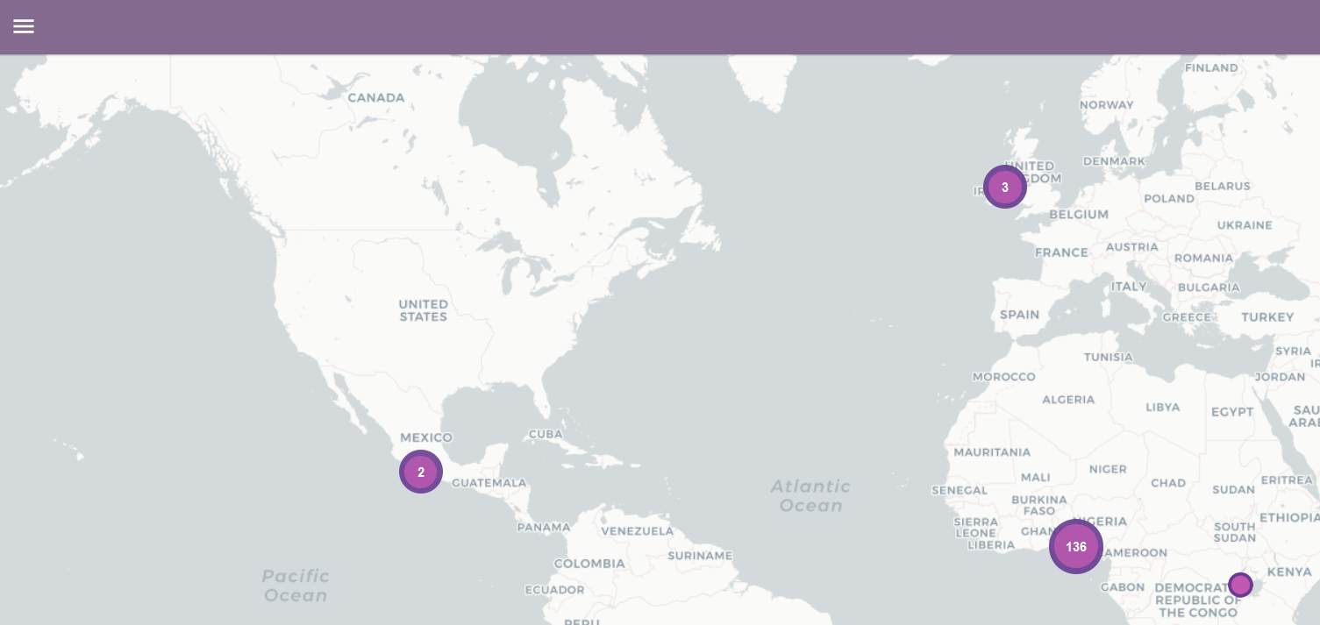
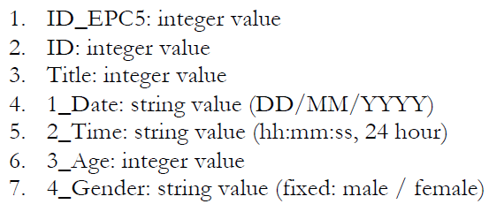
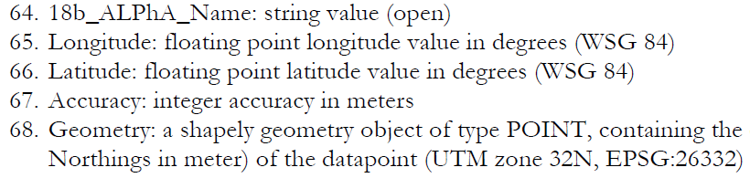
CONTEXTUALIZATION: THE DATA
→ Data retrieval REST API
→ Clean Up (Columns, Outliers)
→ Geodatabase PostgreSQL (PostGIS)
(…)

Slide 4
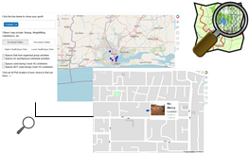

REQUIREMENT ANALYSIS AND SPECIFICATION
Users: citizens of Lagos (active/passive), policymakers, urban planners, researchers, NGOs…
Goal: contribute to the growth of the community-led network
Objective: Allow interactive and customizable data visualization to user needs and encourage contribution to the project

Slide 5



SYSTEM DESIGN OVERVIEW
BROWSER - CLIENT
Web browser as a client, user request services and resources to system displayed on webpage.
Web server and WSGI server (Python) for the client’s requests, serving, and performing the demanded operations.
DBMS that handles and interacts with the Epicollect5 database and other databases such as the system tables.
DBMS

Slide 6
SYSTEM DESIGN FUNCTIONAL SPECIFICATIONS
A mapping tool: comprising a base map layer (OSM) displaying the city. The map will be a dynamic element with which the user can interact.
At-a-glance-view (Pop-up Dashboard): of 3 main attributes of the marked ALPhA sites.
A data analysis tool: Application of various widget filters will allow the user to display subsets of the data, based on their personal needs.
Individual presentation of data: In-the-map-view of the data nodes (filtered or unfiltered), by clicking it is redirected to a more extensive page of that ALPhA space
A dynamic element : weather forecast for the day.
An incentive to contribute: Section where the user shall receive further references and information on the objective of the ALPhA study and on the organizers.

Slide 7
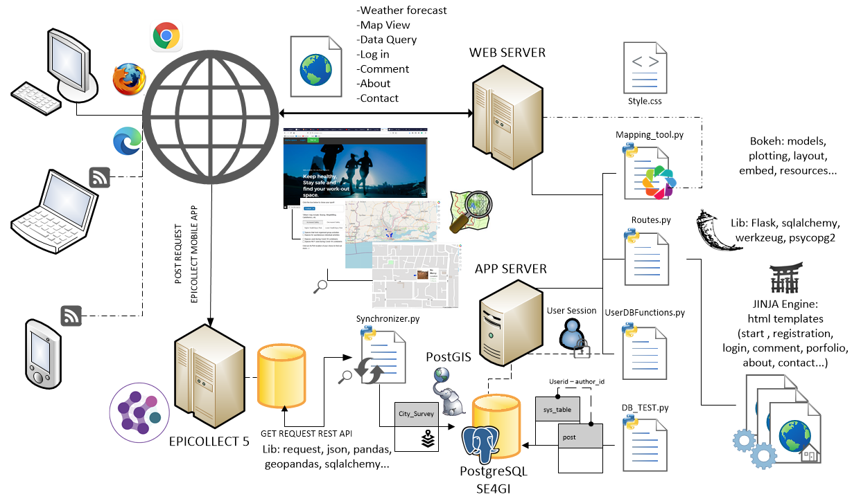
SYSTEM DESIGN SCHEMA

Slide 8
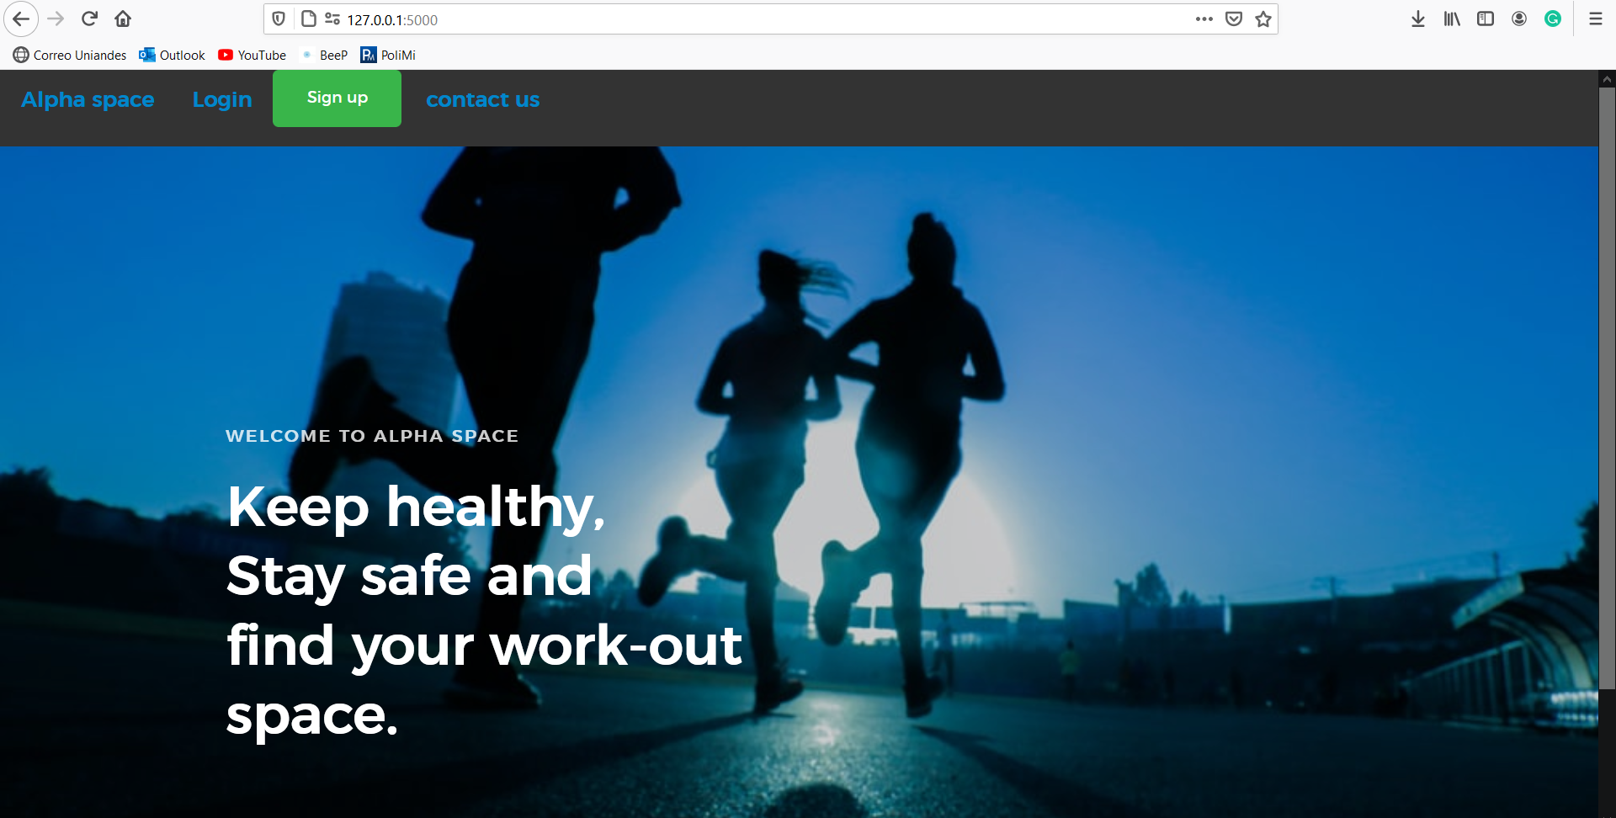
WEB APP DEMO

